Slide 1
Today
Educational context for second language acquisition.
Break (10 min)
Course overview.

Slide 2

Educating Language Minority Students and Affirming their Equal Rights: Research and Practical Perspectives
Kenji Hakuta
Stanford University
Notes:
Thank Brown Selection committee, AERA staff.

Slide 3




Policy and Practice:
Carrots and Sticks
Civil Rights Act, EEOA, Castañeda interpretation.
Elementary and Secondary Education Act Title I, Title III…
Notes:
3

Slide 4
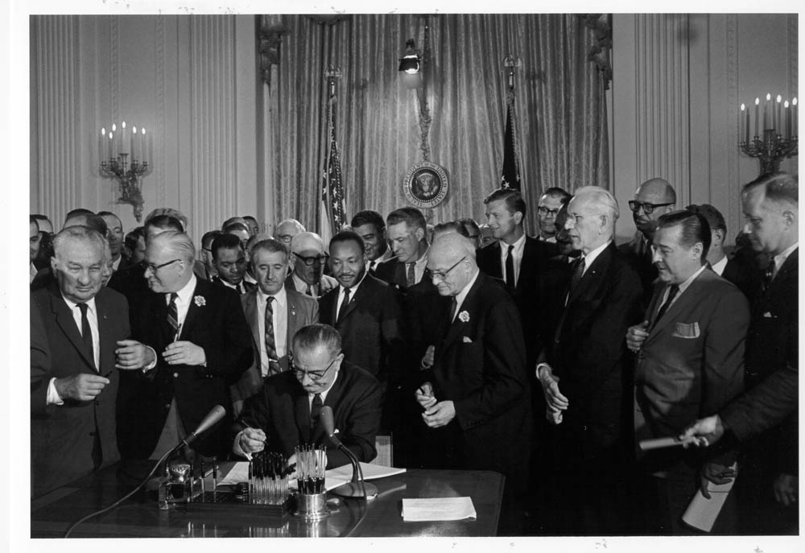
Civil Rights Act of 1964

Slide 5
Lau v. Nichols (1974)
There is no equality of treatment merely by providing students with the same facilities, textbooks, teachers and curriculum; for students who do not understand English are effectively foreclosed from any meaningful education.
U. S. Supreme Court
Lau v. Nichols 1974

Slide 6
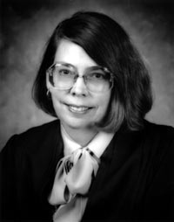
Castañeda v. Pickard (1981)
Fifth Circuit Court of Appeals
(1) Whether the school system is pursuing a program informed by an educational theory recognized as sound by some experts in the field, or, at least, deemed a legitimate experimental strategy.
(2) Whether the programs and practices actually used by the school system are reasonably calculated to implement effectively the educational theory adopted by the school.
(3) Whether the school's program succeeds, after a legitimate trial, to produce results indicating that the language barriers confronting students are actually being overcome.
Sound theory
revise
examine
Judge Carolyn Randall (King)
Results
reform
Implementation
evaluate
648 F.2d 989; 1981 U.S.
Notes:
6

Slide 7
Sound theory?

Slide 8

A couple of cognitive scientists…

Slide 9

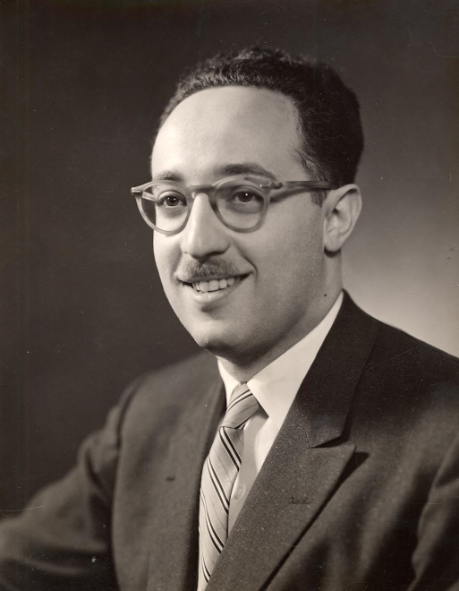
Center for Applied Linguistics

Slide 10
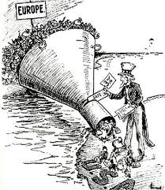
A long history of negativity about immigrants, bilingualism and bilinguals…
“These immigrants are beaten men from beaten races, representing the worst failures in the struggle for existence…. Europe is allowing its slums and its most stagnant reservoirs of degraded peasantry to be drained off upon our soil.”
-- Francis A. Walker, President of M.I.T.

Slide 11

“There can be no doubt that the child reared in a bilingual environment is handicapped in his language growth. One can debate the issue as to whether speech facility in two languages is worth the consequent retardation in the language of the realm.”
-George Thompson (1952)

Slide 12

Reagan Cabinet and Secretary of Education William Bennett

Slide 13
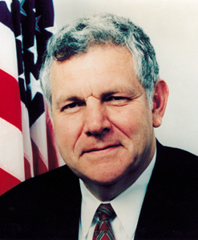
Bilingual Education
“Despite a Federal investment of $1.7 billion over 17 years (currently about $139 million annually), research has not shown transitional bilingual education to be more successful than other methods of instruction in helping non-English speaking children become prificient in English. “ (William Bennett, Sept. 26, 1985)
Cap on SAIPs (Special Alternative Instructional Programs).
Limit on length of service provided.

Slide 14
Bilingual Education v. English-Only Horse Race
One kind of theory

Slide 15
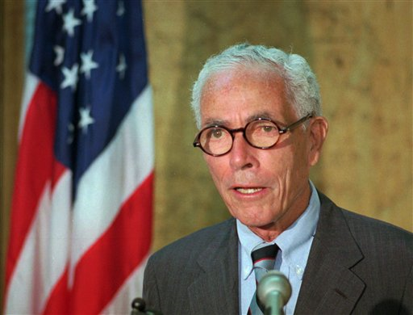
Sen. Claiborne Pell:
“It should be 6 months”
Another kind of theory…

Slide 16


My kind of theory…
I think that bilingualism is a good thing…

Slide 17
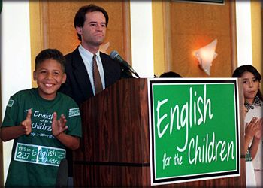
Continuing dominance of “language of instruction” debate and time frame expectation.
1974
1998
Notes:
Yet the policy debates in this area have focused on the learning of English and on access to academic content through English, and almost never on bilingualism. This is most evident in divisive ballot initiatives such as Proposition 227 that is a textbook example of wedge politics.
17

Slide 18
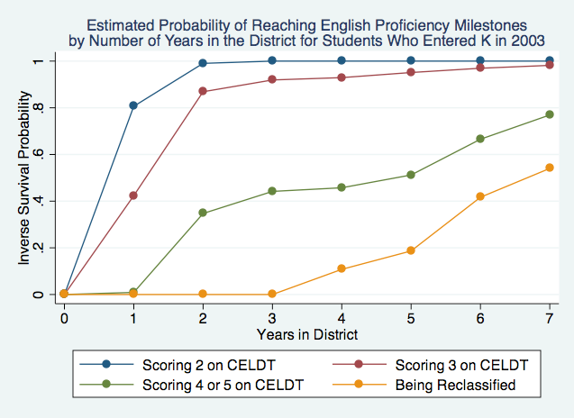

Slide 19
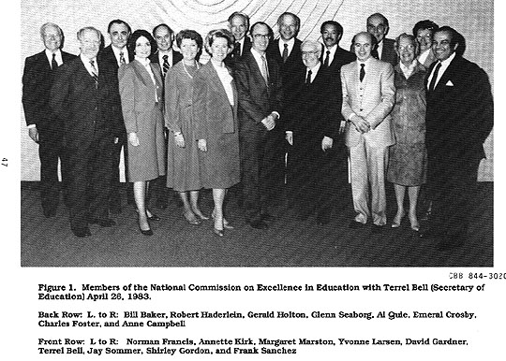
A Nation at Risk (1983)
… call for standards (another theory)

Slide 20

Stanford Working Group (1992)

Slide 21
Basic Values / Principles
Language-minority students must be provided with an equal opportunity to learn the same challenging content and high-level skills that school reform movements advocate for all students.
Proficiency in two or more languages should be promoted for all students. Bilingualism enhances cognitive and social growth, competitiveness in a global marketplace, national security, and understanding of diverse peoples and cultures.
Notes:
Let me start with a couple of principles, borrowed from the Stanford Working Group back in the 1990’s. These principles are still useful in the present day, and continue as the foundation for the values that we hold as we work on the current reauthorization, as well as how ARRA funds could be used for ELLs.
21

Slide 22
IASA: Inclusion in Title I Accountability
Section 1111(b)(3)(F) requires States to assess LEP students, to the extent practicable, in the language and form most likely to yield valid results. That section also requires States to provide reasonable accommodations and adaptations necessary to measure the achievement of LEP students relative to State content standards.
(ELEMENTARY & SECONDARY EDUCATION Summary Guidance on the Inclusion Requirement for Title I Final Assessments, downloaded at http://www2.ed.gov/policy/elsec/guid/inclusion.html)

Slide 23
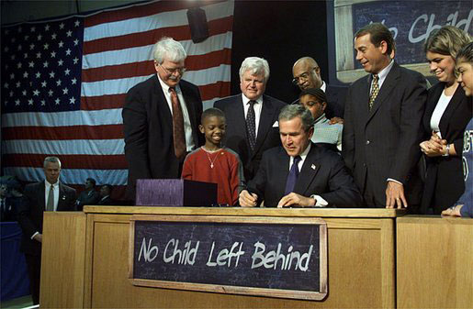
No Child Left Behind

Slide 24

No Child Left Behind:
Three important pieces for ELLs
Sec. 1111(a)(3)(ix)(III) the inclusion of limited English proficient students, who shall be assessed in a valid and reliable manner and provided reasonable accommodations on assessments administered … including, to the extent practicable, assessments in the language and form most likely to yield accurate data…
Sec. 1111(a)(3)(xiii) enable results to be disaggregated within each State, local educational agency, and school by…English proficiency status.
Sec 3113(b)(2) standards and objectives for raising the level of English proficiency that are derived from the four recognized domains of speaking, listening, reading, and writing, and that are aligned with achievement of the challenging State academic content and student academic achievement standards described in section 1111(b)(1).

Slide 25
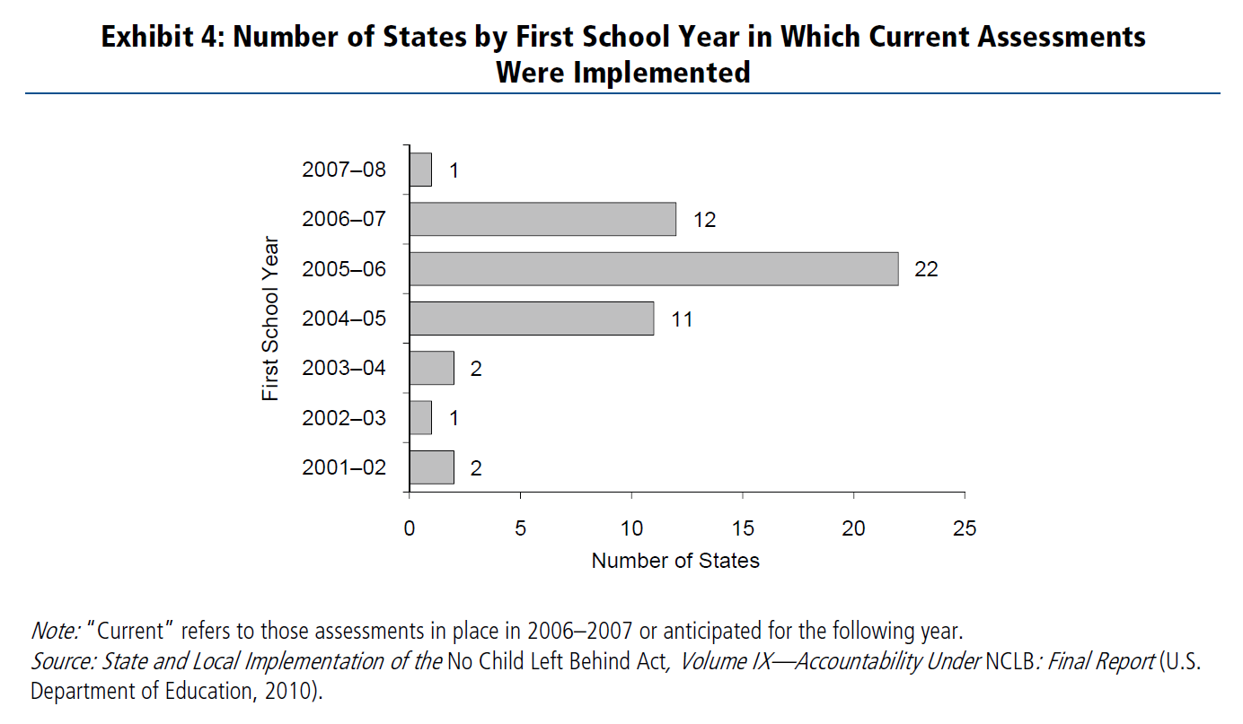
NCLB Implementation
Ramsey, A. & O’Day, J. (2010). Title III Policy: State of the States. ESEA Evaluation Brief: The English Language Acquisition Act, Language Enhancement, and Academic Achievement Act. Washington, DC: American Institutes for Research.

Slide 26
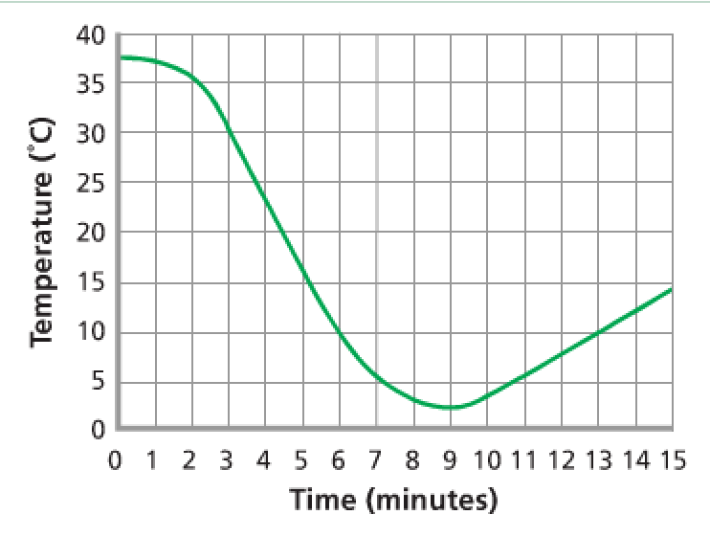
Academic Language
From chapter on chemical change:
“At what temperature did the reaction stop? How can you tell?”

Slide 27


Slide 28
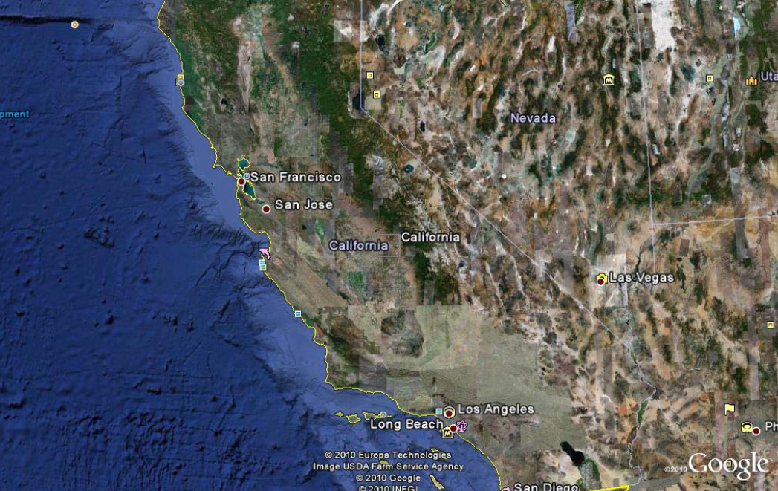

Slide 29
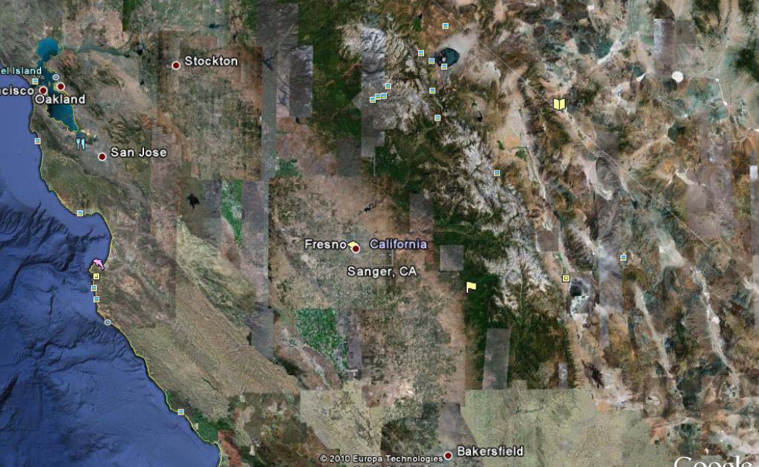

Slide 30
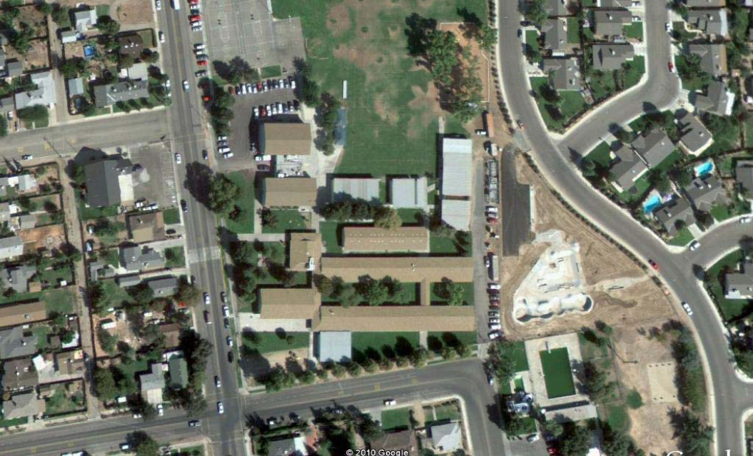

Slide 31
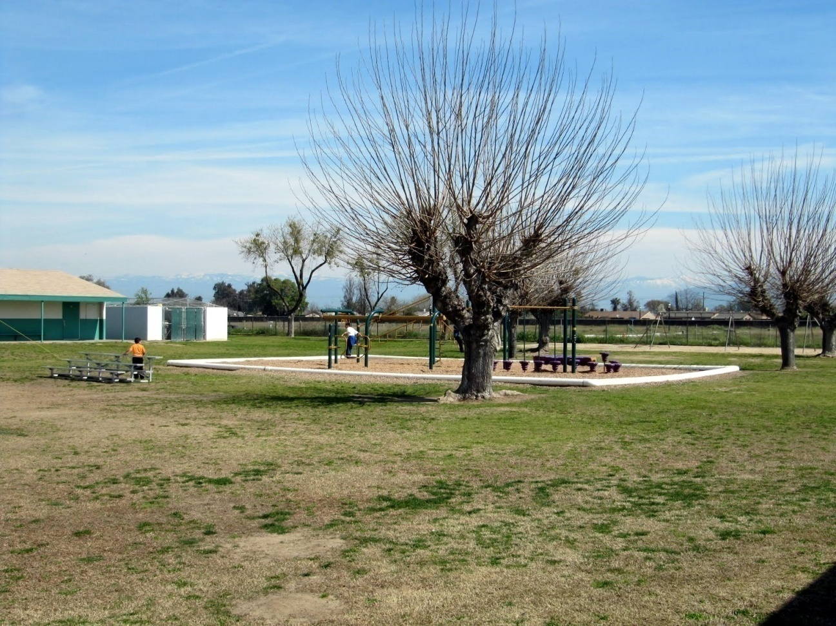
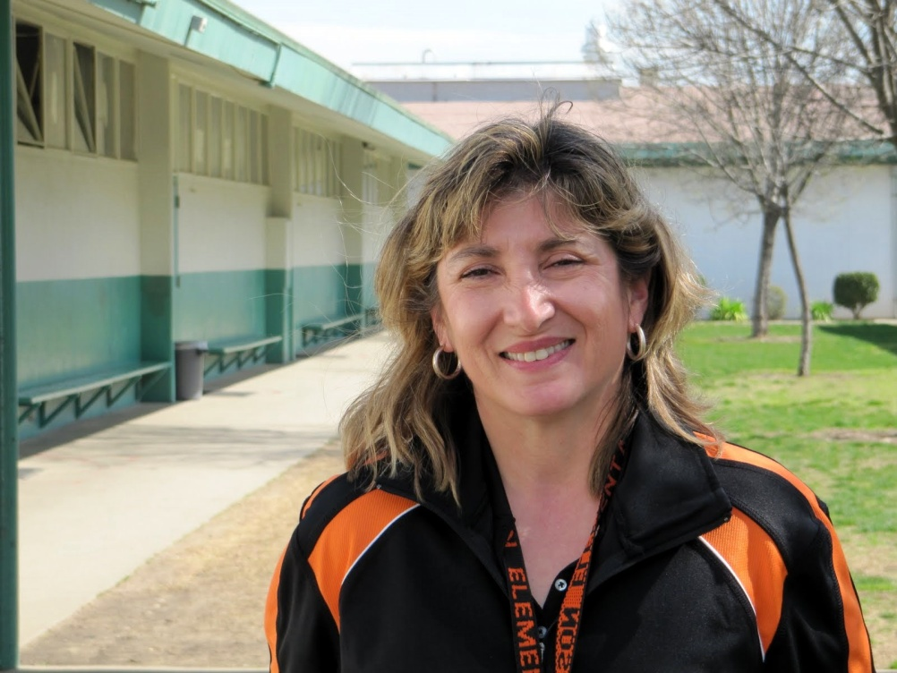

Slide 32


Slide 33
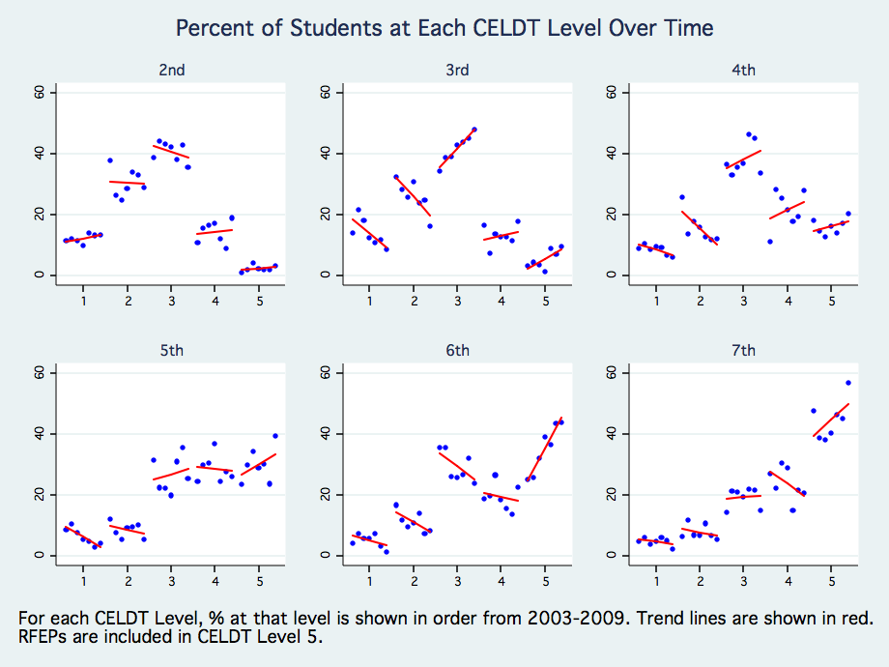
Showing Growth in English Language Proficiency Development
Notes:
Time expectations for English proficiency development is key, and policy either ignores this, or has unrealistic expectations, such as that kids should learn English in one year. This is not realistic. Data solidly show that even in the best-performing of districts, it takes five or more years for most ELLs to attain proficiency in English. Look at these data from Sanger. It is not until the 5th grade that most of the ELLs are in the higher levels of English proficiency. So, we think that 5 years is a realistic but ambitious expectation for most school districts, and that policy should drive toward this expectation.

Slide 34
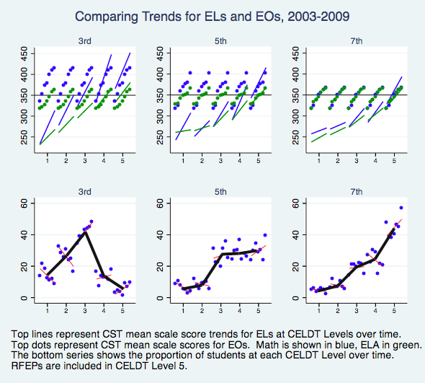
Narrowing the EL-EO Gap

Slide 35
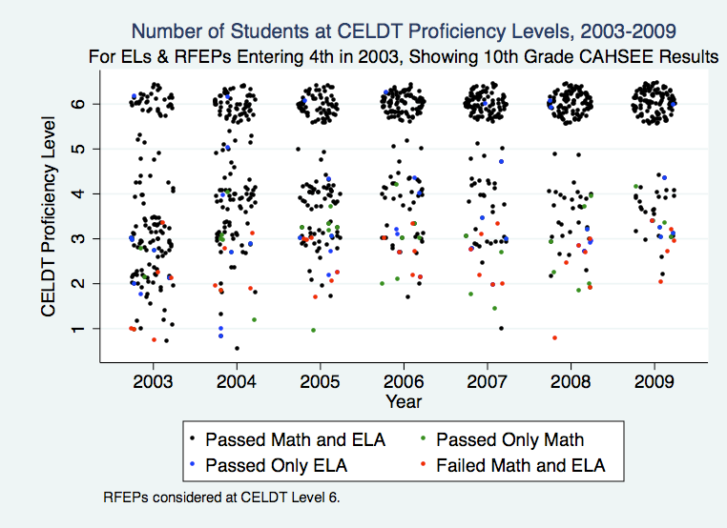
Toward High School Graduation
19% 35% 38% 52% 59% 55% 70%
Notes:
Longitudinal picture of high stakes outcomes of EL and RFEP students taking CAHSEE in 10th grade in 2009, backward mapping those students’ CELDT scores to 4th grade. Color dots show those who failed CAHSEE in 10th grade. These show that getting kids in grades 4-6 out of CELDT 3 should be a high priority as far as CAHSEE pass likelihood.

Slide 36

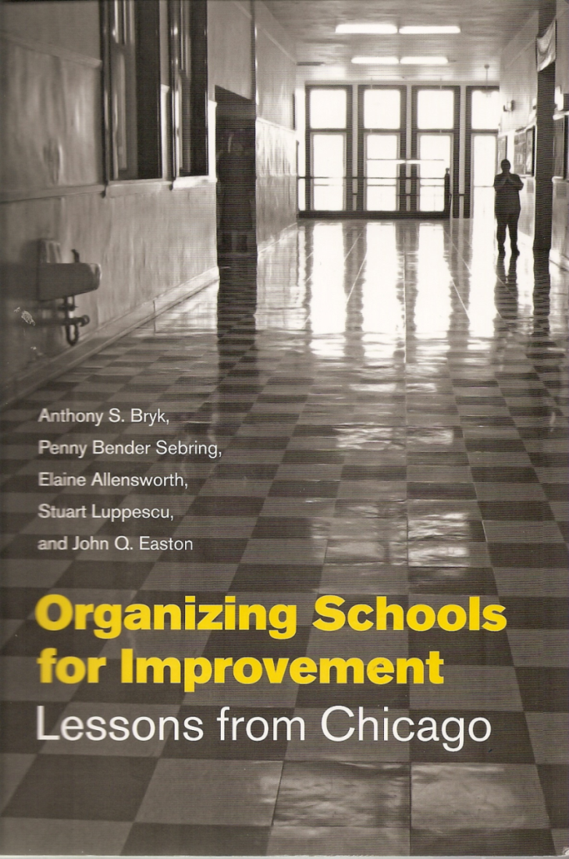

http://www.edsource.org/pub_SimStu_EL9-07_lay-report.html
http://www.cgcs.org/publications/ELL_Report09.pdf

Slide 37
http://www.edsource.org/pub_SimStu_EL9-07_lay-report.html
http://www.cgcs.org/publications/ELL_Report09.pdf
Schoolwide vision and culture …

Slide 38
http://www.edsource.org/pub_SimStu_EL9-07_lay-report.html
http://www.cgcs.org/publications/ELL_Report09.pdf
Staff capacity and focus…

Slide 39
http://www.edsource.org/pub_SimStu_EL9-07_lay-report.html
http://www.cgcs.org/publications/ELL_Report09.pdf
Stable leadership…

Slide 40
http://www.edsource.org/pub_SimStu_EL9-07_lay-report.html
http://www.cgcs.org/publications/ELL_Report09.pdf
ELD and core curriculum…

Slide 41
http://www.edsource.org/pub_SimStu_EL9-07_lay-report.html
http://www.cgcs.org/publications/ELL_Report09.pdf
Use of assessment and data…

Slide 42
http://www.edsource.org/pub_SimStu_EL9-07_lay-report.html
http://www.cgcs.org/publications/ELL_Report09.pdf
Parents, community, trust…

Slide 43
What we have learned…
We don’t need to be scared by bilingualism, although we probably will continue to be, because it’s a cultural thing.
English language development takes time -- we can be more focused and direct, but it still takes time.
There is something called “academic language” that goes beyond just the vocabulary of the content glossary – and it would be a good thing to get content teachers engaged with its development.
Long-term English learners demand particular attention.
Strong relationships exist between English proficiency development and content area achievement, even using imperfect present-day measures.
Standards, assessment, and accountability practices that are inclusive of ELs have gained some ground and traction in school and district practice.
School and district organization and leadership to create coherence do seem to matter.

Slide 44
What we have learned…
We don’t need to be scared by bilingualism, although we probably will continue to be, because it’s a cultural thing.
English language development takes time -- we can be more focused and direct, but it still takes time.
There is something called “academic language” that goes beyond just the vocabulary of the content glossary – and it would be a good thing to get content teachers engaged with its development.
Long-term English learners demand particular attention.
Strong relationships exist between English proficiency development and content area achievement, even using imperfect present-day measures.
Standards, assessment, and accountability practices that are inclusive of ELs have gained some ground and traction in school and district practice.
School and district organization and leadership to create coherence do seem to matter.

Slide 45
What we have learned…
We don’t need to be scared by bilingualism, although we probably will continue to be, because it’s a cultural thing.
English language development takes time -- we can be more focused and direct, but it still takes time.
There is something called “academic language” that goes beyond just the vocabulary of the content glossary – and it would be a good thing to get content teachers engaged with its development.
Long-term English learners demand particular attention.
Strong relationships exist between English proficiency development and content area achievement, even using imperfect present-day measures.
Standards, assessment, and accountability practices that are inclusive of ELs have gained some ground and traction in school and district practice.
School and district organization and leadership to create coherence do seem to matter.

Slide 46
What we have learned…
We don’t need to be scared by bilingualism, although we probably will continue to be, because it’s a cultural thing.
English language development takes time -- we can be more focused and direct, but it still takes time.
There is something called “academic language” that goes beyond just the vocabulary of the content glossary – and it would be a good thing to get content teachers engaged with its development.
Long-term English learners demand particular attention.
Strong relationships exist between English proficiency development and content area achievement, even using imperfect present-day measures.
Standards, assessment, and accountability practices that are inclusive of ELs have gained some ground and traction in school and district practice.
School and district organization and leadership to create coherence do seem to matter.

Slide 47
What we have learned…
We don’t need to be scared by bilingualism, although we probably will continue to be, because it’s a cultural thing.
English language development takes time -- we can be more focused and direct, but it still takes time.
There is something called “academic language” that goes beyond just the vocabulary of the content glossary – and it would be a good thing to get content teachers engaged with its development.
Long-term English learners demand particular attention.
Strong relationships exist between English proficiency development and content area achievement, even using imperfect present-day measures.
Standards, assessment, and accountability practices that are inclusive of ELs have gained some ground and traction in school and district practice.
School and district organization and leadership to create coherence do seem to matter.

Slide 48
What we have learned…
We don’t need to be scared by bilingualism, although we probably will continue to be, because it’s a cultural thing.
English language development takes time -- we can be more focused and direct, but it still takes time.
There is something called “academic language” that goes beyond just the vocabulary of the content glossary – and it would be a good thing to get content teachers engaged with its development.
Long-term English learners demand particular attention.
Strong relationships exist between English proficiency development and content area achievement, even using imperfect present-day measures.
Standards, assessment, and accountability practices that are inclusive of ELs have gained some ground and traction in school and district practice.
School and district organization and leadership to create coherence do seem to matter.

Slide 49
What we have learned…
We don’t need to be scared by bilingualism, although we probably will continue to be, because it’s a cultural thing.
English language development takes time -- we can be more focused and direct, but it still takes time.
There is something called “academic language” that goes beyond just the vocabulary of the content glossary – and it would be a good thing to get content teachers engaged with its development.
Long-term English learners demand particular attention.
Strong relationships exist between English proficiency development and content area achievement, even using imperfect present-day measures.
Standards, assessment, and accountability practices that are inclusive of ELs have gained some ground and traction in school and district practice.
School and district organization and leadership to create coherence do seem to matter.

Slide 50
What we have learned…
We don’t need to be scared by bilingualism, although we probably will continue to be, because it’s a cultural thing.
English language development takes time -- we can be more focused and direct, but it still takes time.
There is something called “academic language” that goes beyond just the vocabulary of the content glossary – and it would be a good thing to get content teachers engaged with its development.
Long-term English learners demand particular attention.
Strong relationships exist between English proficiency development and content area achievement, even using imperfect present-day measures.
Standards, assessment, and accountability practices that are inclusive of ELs have gained some ground and traction in school and district practice.
School and district organization and leadership to create coherence do seem to matter.

Slide 51
What to look forward to…
ESEA reauthorization
Common Core Standards
Maybe some positive attention to bilingualism, if we can get the courage.

Slide 52
Today: Introduction
What is the nature of the interdisciplinary field of research (linguistics, psychology, sociology, anthropology) that comprise second language acquisition?
What areas of education policy and practice requires knowledge about the second language acquisition process?
What is the difference between second language acquisition and foreign language learning?
How have researchers addressed the relationship between language and cognition?

Slide 53
Federal and state policy framework.
How does federal law and policy address the needs of English language learners (ELLs)?
How do the policies reflect the distinction between language acquisition and cognitive development for English language learners?
What is the accountability framework with respect to the academic development of ELLs?
What potential influence does the Common Core Standards have on standards, instruction, and expectations for ELLs with respect to their acquisition of English?

Slide 54
Linguistic Theory
How has linguistic theory treated differences between languages?
What implications does the theoretical stance have on our understanding of second language learners?
Does the first language matter in the acquisition of the second language?

Slide 55
Developmental Expectations
What expectations should we have about the rate of second language acquisition?
What factors might condition the rate of acquisition?
How should accountability systems set targets for English language proficiency development?

Slide 56
Language Acquisition in School Settings
How valid are standardized measures of second language acquisition?
To what extent is linguistic knowledge stand-alone or the product of the relationship between the student, the context, and language?

Slide 57
Explicit direct instruction of English in classroom instructional settings.
Is explicit direct instruction of language forms and functions effective?
Is language different in any way from other domains of cognition such as reading and math?

Slide 58
The ELD Curriculum
How is the English language development (ELD) curriculum shaped by theories of linguistics and language acquisition?
What is the relationship between the state standards in English language proficiency and the curriculum?
What are the prospects for the influence of the Common Core Standards in re-shaping state English language proficiency standards?
How have theories of first language acquisition influenced ways of thinking about second language acquisition?

Slide 59
Constraints on second language acquisition: age, SES, etc.
Is there a critical period for second language acquisition?
What is the relationship between socioeconomic status and second language acquisition?
Are there other constraints (non-universal claims) that might be advanced about second language acquisition?

Slide 60
What is "academic language"?
What does CELDT (the California English Language Development Test) measure?
How is it aligned to the state English Language Proficiency Standards?
Is there more to the concept of academic language than what it is *not*?
How might academic language be situated within disciplinary contexts?
What is the best way to think about how teachers develop "language objectives" in programs such as sheltered instruction?

Slide 61
Teacher qualities for supporting second language acquisition.
What do teachers need to know about language in order to be effective in teaching English language learners?
What kinds of expectations might be built into state certification requirements for such teachers?

